Slide 1
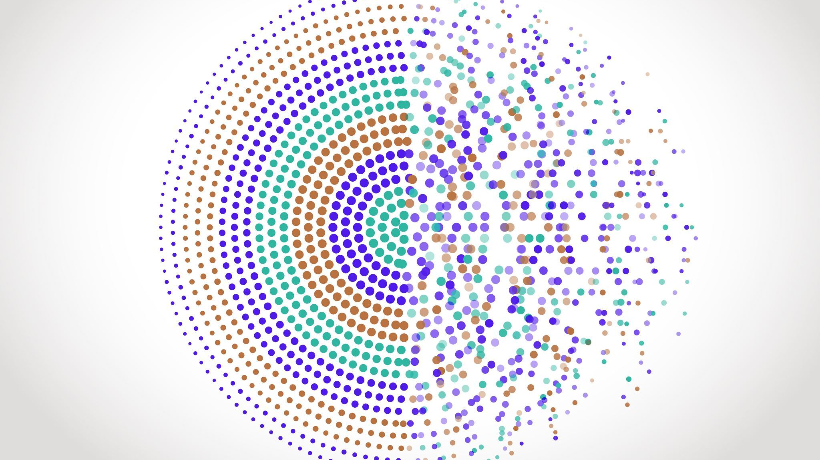
Project Proposal
Digital Innovation Project Proposal

Slide 2
Brainstorm
Type of project: Game
Game types:
FPS, survival, horror, platformer, rhythm
Idea: Rhythm Game
Requirements: Playable window, input detection, music, notes, note accuracy
Extra: Score keeping, different music, extra customization (Note types, colour, note speed), map gimmicks
Game Engine? Yes. Godot due to familiarity.

Slide 3
ProjecT IDea
Project Summary:
A multi-key rhythm game
Similar Projects:
Project: RUSHER (A rhythm game on roblox)
Osu! Mania
Quaver

Slide 4
Tools and Digital Components
Please list the digital components you will use to create this outcome alongside its tools.
Godot, image editing software (To create textures), the internet

Slide 5
Scope
What is the scope of your project:
The ability to pick a song to play and press any valid key to hit and remove notes during the song. When the song ends the user returns to the song select screen to play again.
Example:
A character that is animated that can walk on a field plant and water crops and collect them for money.

Slide 6
Standard Selection
Standard Name | Credits
Develop an Outcome | 6
External: Reflect on an outcome | 3
Programming | 6
Media Outcome | 4
Total | 19

Slide 7
Skills
Skills I currently have
Skills I need to learn
Coding
Digital art
Problem solving
I’m unsure

Slide 8
Teacher/Student Sign Off
I Josh Dean am now committed to completing this project.
I will have 30 weeks to complete the entire project and if falling behind will take my own initiative to catch up.
Signed: ___________________________________
Teacher Sign Off:___________________________

